Slide 1

An automated system to limit COVID-19 using
Facial Mask Detection in a smart city Network
Date : 28 May 2021
Kanumuri SumaVallika - 17wh1a0542
Praneetha Bhupathiraju - 17wh1a0551
Bathula Varshitha Veena -17wh1a0557
Internal Guide : K . Rajesh
Designation : Assistant Professor
Department of Computer Science and Engineering
BVRIT HYDERABAD College of Engineering for Women

Slide 2
ABSTRACT
COVID-19 pandemic caused by the novel coronavirus is continuously spreading until now all over the world
A system that restricts the growth of COVID-19 by finding out people who are not wearing any facial mask in a smart city network where all the public places are monitored with Closed-Circuit Television (CCTV) cameras.
We present a method to generate accurate face segmentation masks from any arbitrary size input image. This would be a useful tool to reduce the spread of this communicable disease for many countries in the world.
BVRIT HYDERABAD College of Engineering for Women

Slide 3
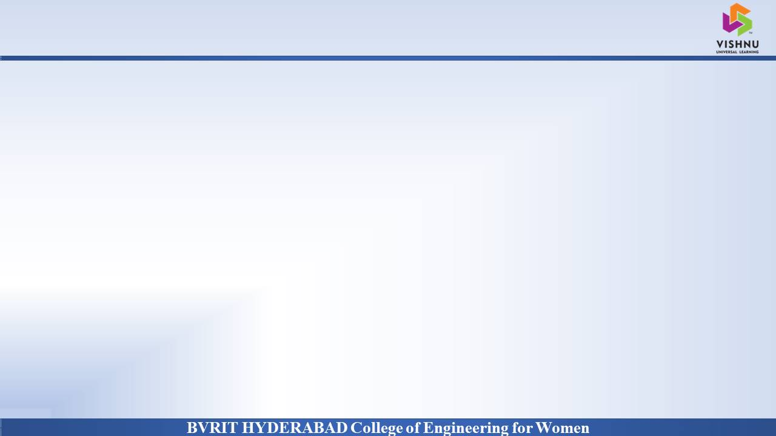
Why Should I Study this course?
PROJECT INTRODUCTION
Examples
Domain:
AI/ML
Proposed System:
COVID-19 facial mask detection is an application which restricts the growth of COVID-19 by finding people who are not wearing masks in public places which are monitored with Closed-Circuit Television(CCTV) cameras. This would be useful tool to reduce the spread of communicable disease.
BVRIT HYDERABAD College of Engineering for Women

Slide 4
DATASET
The dataset we are working on consists of 4000 images
2010 images containing images of people wearing masks.
1990 images with people without masks.
Drive link:
https://drive.google.com/drive/folders/158ysxTE9E46Xbveo2c4z92Rd6NIwwzsz?usp=sharing
BVRIT HYDERABAD College of Engineering for Women

Slide 5
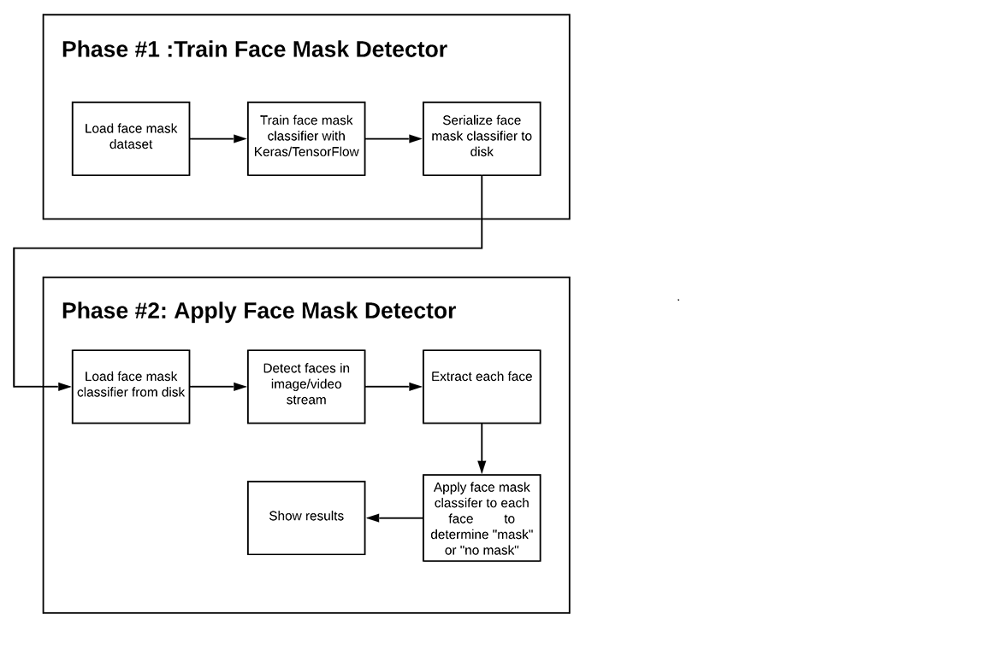
ARCHITECTURE
BVRIT HYDERABAD College of Engineering for Women
BVRIT HYDERABAD College of Engineering for Women

Slide 6
SYSTEM SPECIFICATIONS
Hardware:
Processor - Intel Core i5
Memory(RAM) - 8 GB
Storage – I TB
Software:
Os - windows 10
Google colab
Anaconda Prompt
BVRIT HYDERABAD College of Engineering for Women

Slide 7
TECHNOLOGY STACK
Python Language
Required Packages:
numpy
sklearn
imutils
keras
openCV
Tensorflow
BVRIT HYDERABAD College of Engineering for Women

Slide 8
MODEL
MobileNetV2 is a convolutional neural network architecture that seeks to perform well on mobile devices.
It is based on an inverted residual structure where the residual connections are between the bottleneck layers.
The intermediate expansion layer uses lightweight depthwise convolutions to filter features as a source of non-linearity.
As a whole, the architecture of MobileNetV2 contains the initial fully convolution layer with 32 filters, followed by 19 residual bottleneck layers.
BVRIT HYDERABAD College of Engineering for Women

Slide 9
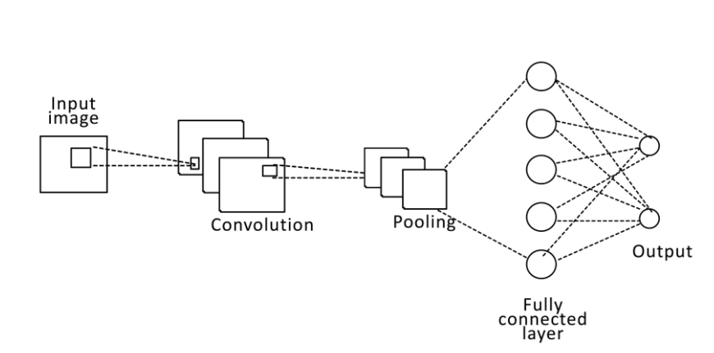
BVRIT HYDERABAD College of Engineering for Women

Slide 10
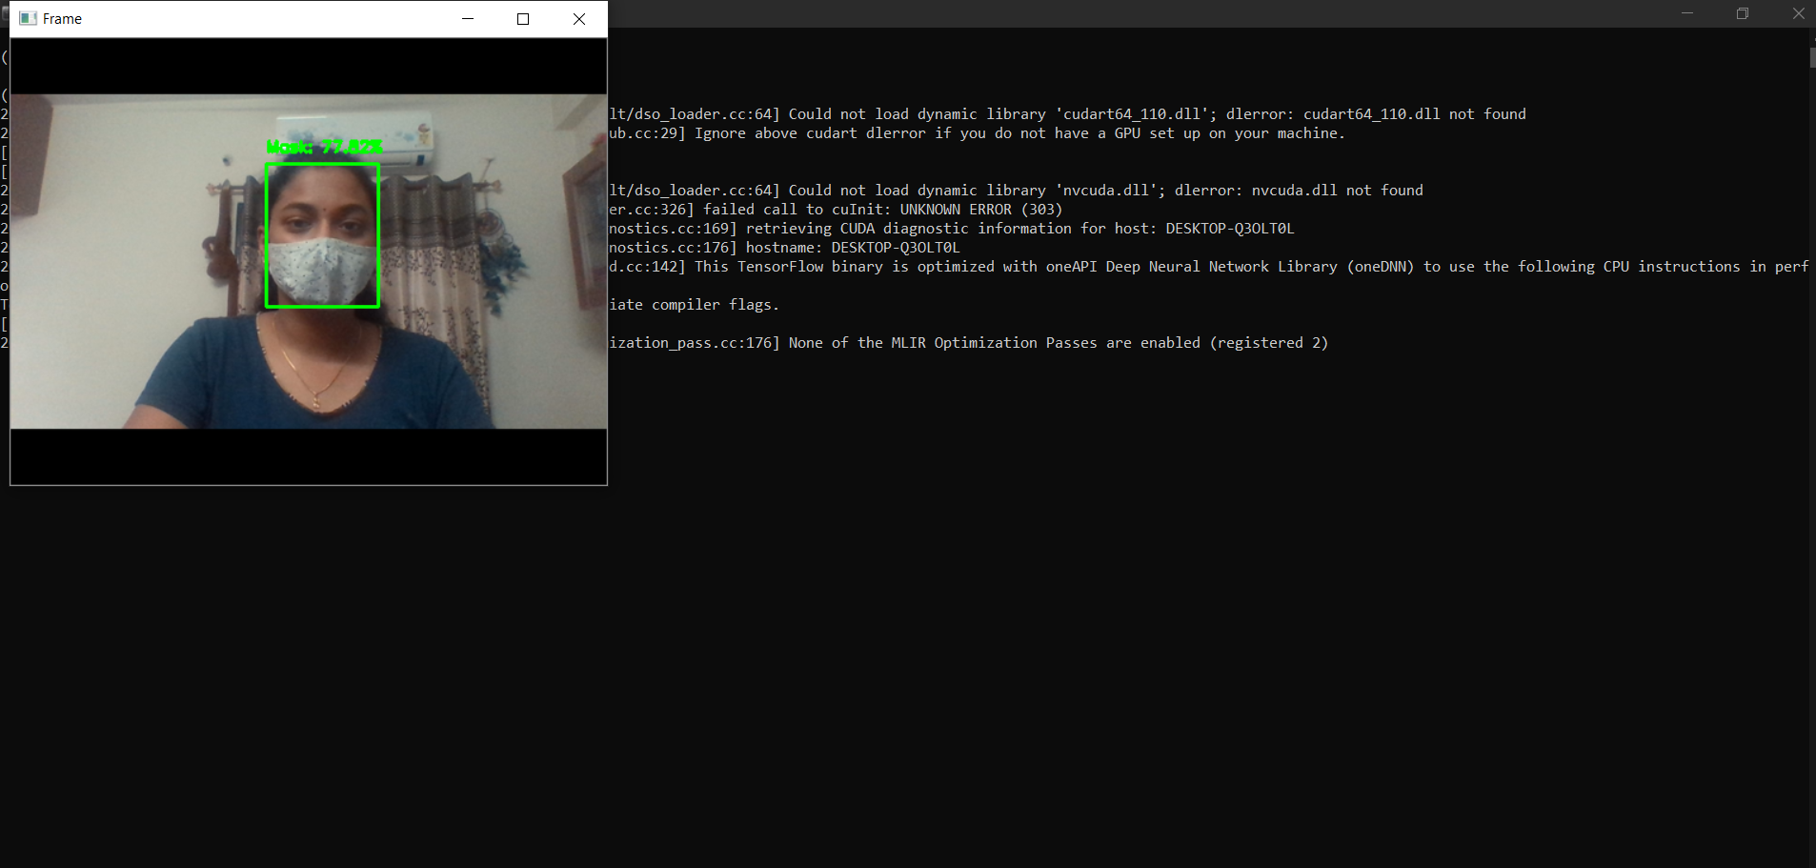
RESULTS
SINGLE PERSON -WITH MASK
BVRIT HYDERABAD College of Engineering for Women

Slide 11
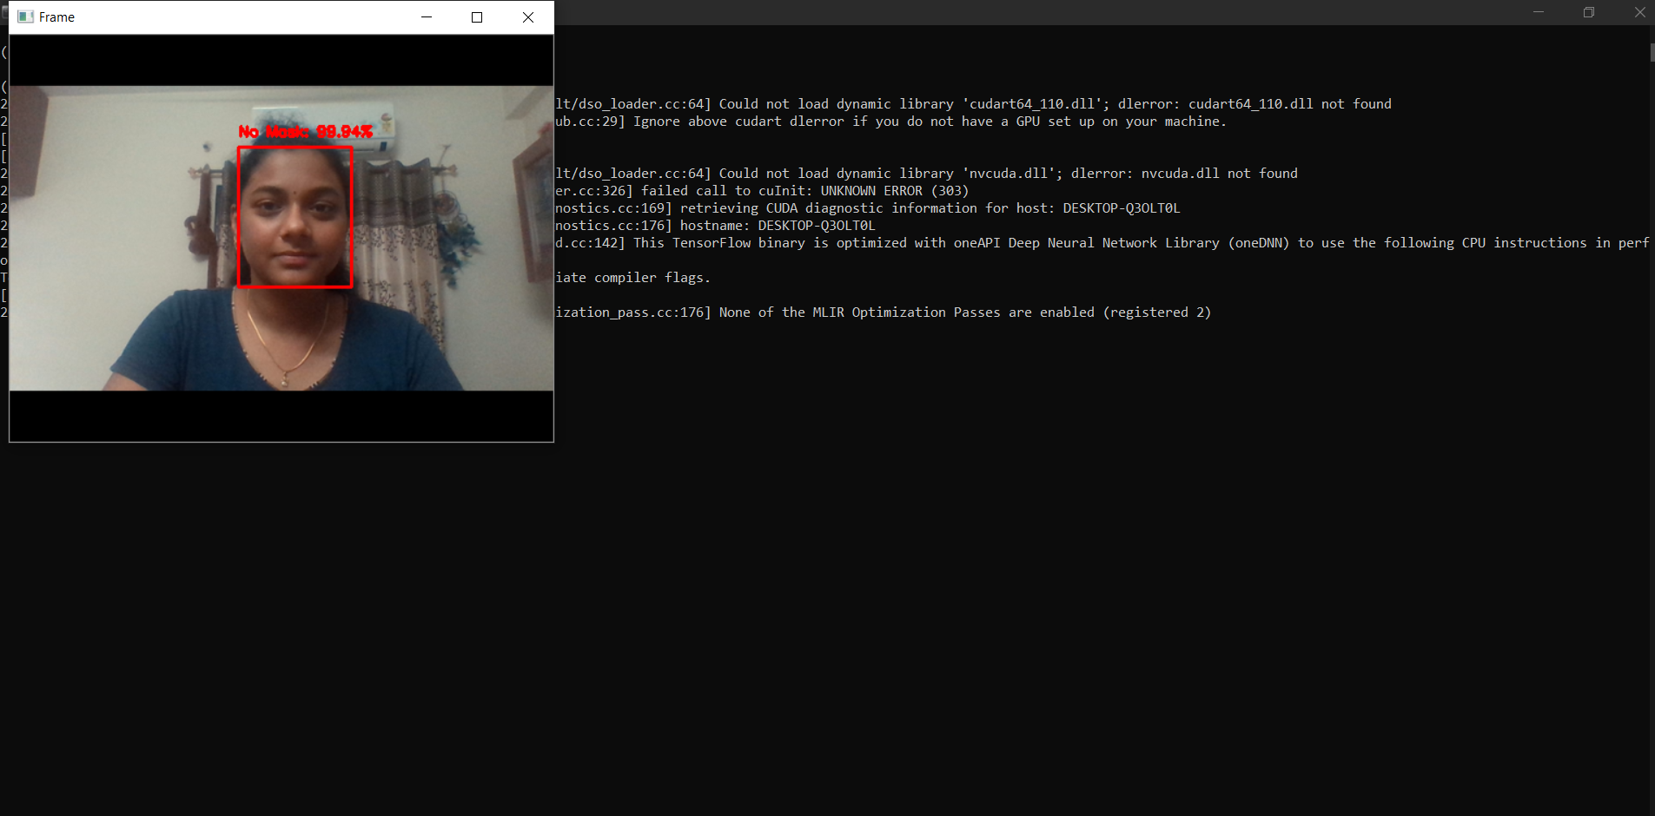
WITHOUT MASK
BVRIT HYDERABAD College of Engineering for Women

Slide 12
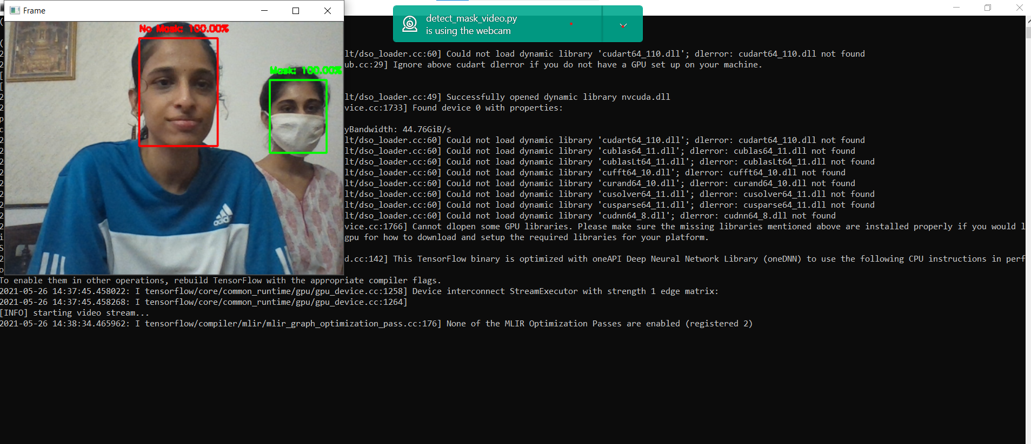
WITH TWO PEOPLE
BVRIT HYDERABAD College of Engineering for Women

Slide 13
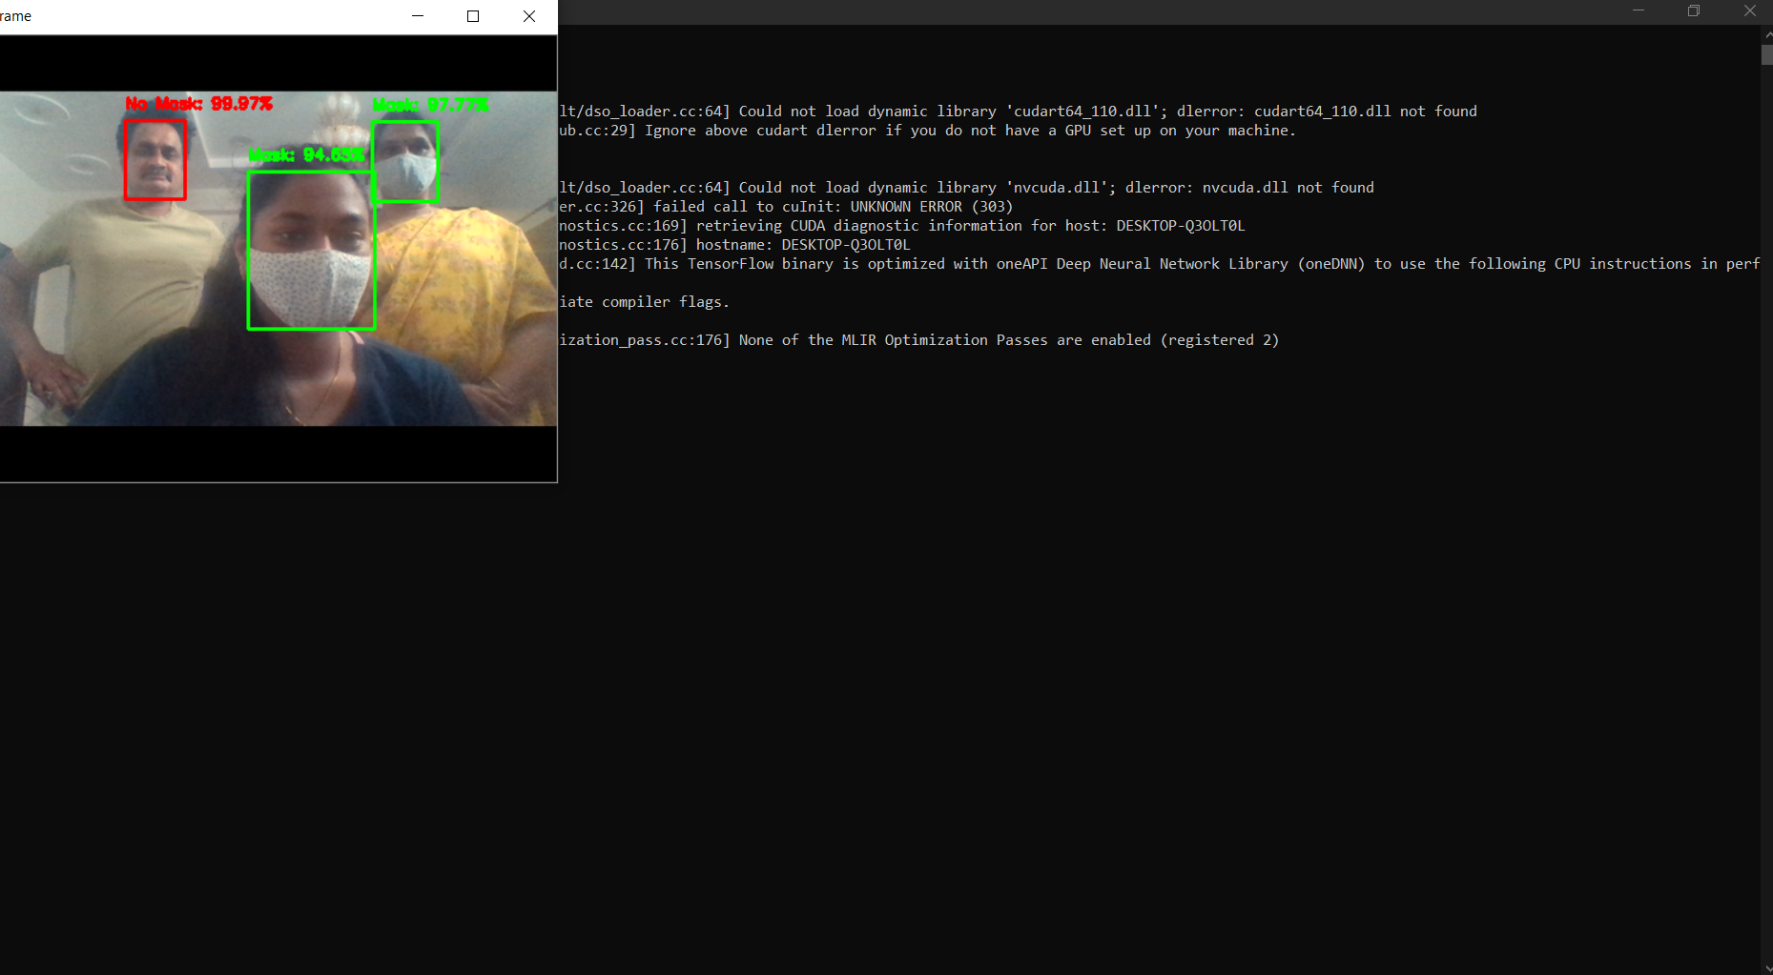
WITH THREE PEOPLE
BVRIT HYDERABAD College of Engineering for Women

Slide 14
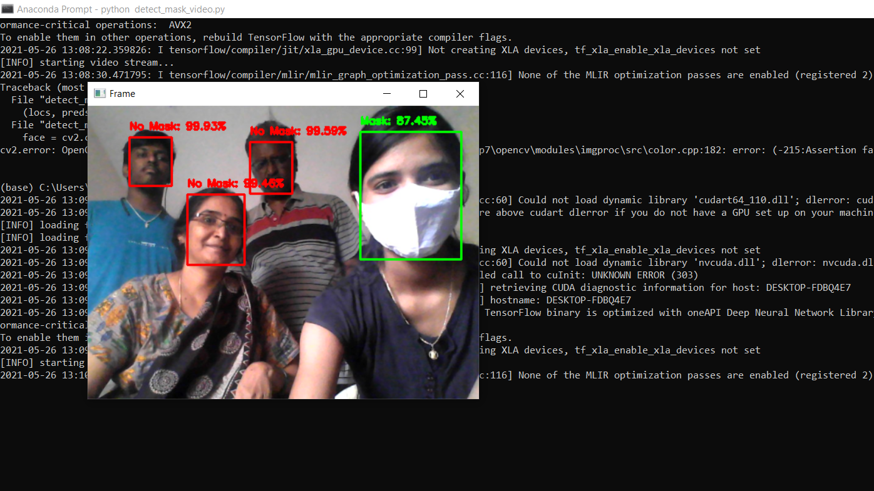
WITH MULTIPLE PEOPLE
BVRIT HYDERABAD College of Engineering for Women

Slide 15
Timeline
Review 0 | Requirements and specifications
Review 1 | Data collection Use Case Diagram
Review 2 | Building a model Training the model
Review 3 | Interpretation of results
BVRIT HYDERABAD College of Engineering for Women

Slide 16
References
Base paper:
https://ieeexplore.ieee.org/stamp/stamp.jsp?arnumber=9216386
https://www.nationalgeographic.com/science/article/face-mask-recognition-has-arrived-for-coronavirus-better-or-worse-cvd
https://www.irjet.net/archives/V7/i8/IRJET-V7I8530.pdf
Reference papers:
BVRIT HYDERABAD College of Engineering for Women

Slide 17
THANK YOU
BVRIT HYDERABAD College of Engineering for Women

